Slide 1
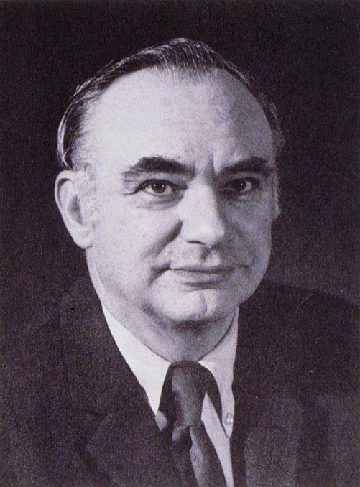
Kenneth T. Whitby Award
American Association for Aerosol Research

Slide 2
This award honors Kenneth T. Whitby, known for his contributions to aerosol measurement, the study of aerosol properties and behavior, and the nature of atmospheric aerosols.
The Kenneth T. Whitby Award
“recognizes outstanding technical contributions to aerosol science and technology by a young scientist. The purpose of the award is to encourage continued work in the field and ongoing support of such endeavors.”

Slide 3
2020 Recipient of the Kenneth T. Whitby Award
Manabu Shiraiwa
University of California, Irvine
Dr. Shiraiwa received a BS and MS at the University of Tokyo, and PhD from the Max Planck Institute for Chemistry in 2011
Associate Professor of Chemistry at the University of California, Irvine
He has worked as group leader at the Max Planck Institute for Chemistry (2013-2016) and as a postdoc fellow at the California Institute of Technology (2012-2013).
Research in: Kinetic modeling of reactiveprocesses of atmospheric organic aerosol, Viscosity and volatility of organic aerosol, and molecular-level processes related to the health impacts of air pollutant
Over 90 articles with an H-index of 37
“His research is highly original and has influenced the thoughts and directions of many other research groups, including my own”

